Slide 1
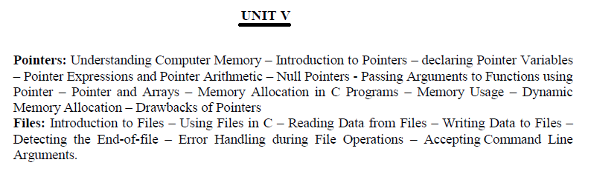

Slide 2
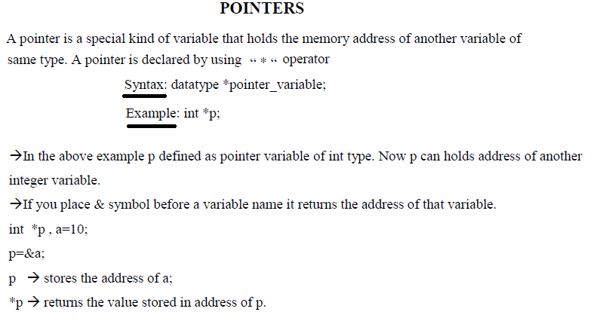

Slide 3
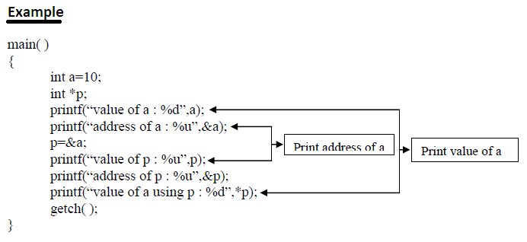

Slide 4
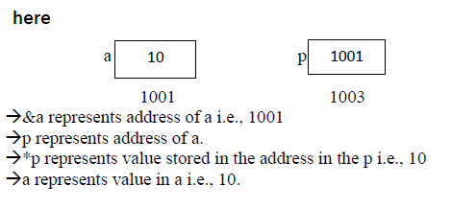

Slide 5
Advantages of Pointers:-
Pointers provide direct access to memory
Pointers provide a way to return more than one value to the functions
Reduces the storage space and complexity of the program
Reduces the execution time of the program
Pointers can be used to pass information back and forth between the calling function and called function.
Pointers allows us to perform dynamic memory allocation and deallocation.
Pointers helps us to build complex data structures like linked list, stack, queues, trees, graphs etc.
Pointers allows us to resize the dynamically allocated memory block.
Addresses of objects can be extracted using pointers

Slide 6
Drawbacks of pointers in c:
Uninitialized pointers might cause segmentation fault.
Pointers are slower than normal variables.
If pointers are updated with incorrect values, it might lead to memory corruption.
Basically, pointer bugs are difficult to debug.

